Slide 1
[How Things Work]: Linux – Networking 1
@khenidak

Slide 2
Where we are. Where we are going. https://aka.ms/k8s/howthingswork
you are here
Processes + IPC
FS + Block Dev
I/O
Networking 1
Networking 2
Virtualization
Containers
Boot + Extending Kernel
Security Roundup
Notes:
We have optimized a bit of our future topics. We want to remain within 10 or 9 sessions. We will further optimize as we learn about how the delivery mechanism

Slide 3
Prologue
Networking in Linux is *MASSIVE*. This session will not tell you everything about everything Networking+Linux.
We will try to enumerate with a degree of details most of the things in networking+kernel. This is not going to be “how to use iptables” session but “how does iptables fit in linux networking” kind of session.
We will spend the first ~10m on core concepts that you may or may not be familiar with.
We will split the content over two session. RX and TX.

Slide 4
Previously on HTW: Code that runs on Linux
H/W interrupt handlers can’t run long and can’t sleep. Interrupts do minimal work then defer the rest. Kernel has many mechanisms for handling deferred work:
* softirq (staticly defined. Run on thread per core: ksoftirqd).
* Tasklets (runtime version of softirq runs on same infra).
Workqueue: thread pool like implementation with delay capability.
* runs with interrupts disabled on CPU.
Code that runs
in a process
softirq
Code that runs in kernel space executing a syscall on behalf of a process
Kernel thread (top half)
Interrupt handler
(bottom half)
H/W
Notes:
- ksoftirqd is operates of list of deferred handlers (typed) executing them one by one in a window then preempted.
Tasklet: concurrent CPUs can not run *same* type of tasklet.
Workqueues are either shared (one across the entire kernel) or dev can create their own. Typically, the shared one is used unless…

Slide 5

Exercise: Send “Hello World!” from Machine A to Machine B
MACs
IPs
Ports+Proto
Hello World!
Frame
MACs
encap
IPs
Ports+Proto
Hello World!
Encap for vxlan, ipsec, tunnels, 6in4, 4in6, etc..
App
Machine –X can be
a router or the eventual receiver. IOW process locally or “route/forward”
Transport
Network
Data Link
NIC-A
NIC-B
Signaling
Machine - A
Machine - B
Networking 101

Slide 6
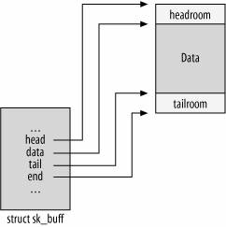
Linux Networking Stack
The stack is layered component stack. Packets flow downward on send and upward on receive. A packet does not have to complete the journey e2e. It can be dropped, routed, re-written* at various stages of the stack.
Packets are represented as ”struct sk_buff” (skbuff || SKB) linked list in kernel. Pointers to skbuff is moved up/down the stack. Skbuff is rarely-if-never copied though some* copying is inevitable.
The interaction with the stack depends on what you are trying to do:
Applications using syscall interface (listen(2) open(2), send(2), receive(2) etc..) for various data plane functions.
Users using ip tool (iproute2 package) to configure control plane devices, address, and routes.
Applications using netlink api to configure the stack. Netlink is control plane over data plane implementation. As in send a specifically formatted packet over a socket to perform a control plane function.
The stack exposes it is own scheduler logic (Traffic Control). TC is hierarchal token bucket implementation. This configurable logic (e.g., limit bandwidth to IP or per device) is used by kworkers that move packets along the stack. The basic principle is to classify packets to match a queue discipline.
The stack offers FIVE hooks (netfilter) IP_PRE_ROUTING, IP_LOCAL_IN, IP_FORWARD, IP_LOCAL_OUT, IP_POST_ROUTING various in-kernel modules can register with these hooks to provide added capabilities. This is what powers xtables (e.g., iptables) modules and the likes of IPVS. Some of these modules have it is own submodules (e.g., CONTRACK**). Each of those kernel modules have it is own “front-end” userspace configuration tool that the kernel does not know or care about. These hooks are also used for xfrm.
The stack allows programmability via ebpf via XDP (RX Only) only works on pre skbuff creation (in kernel or offloaded to device). Or called via TC (OFFLOAD, RX,TX). Or attached to the socket itself (applications has to create the socket then attach the program to it).
The stack itself can be bypassed in multiple ways
Applications can send/receive packets (i.e., raw sockets). Raw socket is a privileged operation.
Applications can read packets off the NIC directly (e.g., DPDK VPP).
Userspace networking stack*.
App
Transport
Network
Data Link
NIC
Networking Stack
sk_buff*: source
Notes:
CONNTrack is a kernel module. However the interface between iptables->conntrack is an iptables modules.

Slide 7
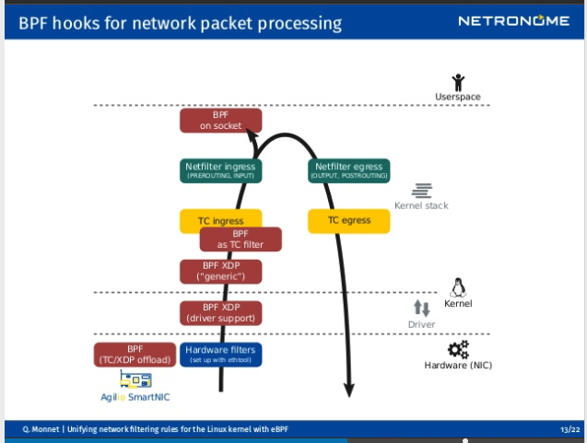
Linux Networking Stack: flow

Slide 8
RX/Ingress

Slide 9
Got Packet! Now What?
Packet arrive at nic which has its own buffer. Then passed to kernel. A packet must be
Processed (aka LOCAL_IN):
Picked by a userspace registered listener at socket via listen(2) or raw socket level via listen(2) + AF_PACKET + SOCK_RAW.
From nic buffers by driver+<thing>. Thing == DPDK || VPP || ?.
Bypass the entire stack by AF_XDP (xdp socket in userspace)
Routed:
Bypass the entire stack by XDP_TX action (goes directly to egress path)
System configured for “packet forwarding” + matching route exists.
Routing can be internal (e.g., network namespace, other v-nic) or external.
Dropped:
Buffers are full
nic buffer is out of space.
Kernel is out of mem (dma zone*).
Socket buffer (normal zone) is out of space.
Special: App’s Accept Queue is full.
By [xdp] ebpf (offloadd on nic or running before kernel logic)
By one of various processing stages (e.g., iptables rule, [TC]ebpf)
Rejected:
Protocol specific such as responding with ICMP packet type 3 (destination unreachable).

Slide 10
data
AF_XDP socket
App
XDP (offload)
AF_PACKET socket
RF ring + napi (DPDK VPP)
XDP (driver)
socket
qdisc bypass
sk_buff created
TC qdisc ingress
protocol
BPF XDP/TC-Filter
xtables pre-routing
xtables input
conntrack
HW
Driver
routing
forward
Kernel/kworker
How does ingress look like?
xfrm and bridge are omitted

Slide 11
Let there be sk_buff
Data* arrives to nic. If there is an offload xdp program it will run it then raises surprise surprise! HW irq.
To avoid irq storms the drivers lower-half can DMA *some* data directly into main memory or – preferred approach - raises a soft IRQ to engage NAPI poll mode to DMA data according to budgeted execution time or until nic is rained. At the end of this process sk_buffs are created in main memory and queued in kernel buffers.
Drivers || XDP can do their own decap/packet rewrite/TX/REDIRECT/DROP. Such as DNAT/SNAT/LB, VXLAN, VPN, CNI, 6in4 etc. Examples: FB’s Katran LB, or Cillium CNI).
Packets can be picked up by AF_XDP socket, RF_RING+NAPI, AF_PACKET (cloned) socket, or just keep going up the stack.
Use ethtool –S <netdev> to learn about packet counters at nic level (driver may have other metrics using other tools).
Use ethtool –g to learn about h/w buffer size.
Use netstat –s to learn about packet counters at stack level.
Note these /proc/sys/net/core/{rmem_default, rmem_max, w*, optmem_max} are for SOCKET memory not NET STACK memory (more on that later).
data
XDP (offload)
XDP (driver)
sk_buff created
Notes:
CONNTrack is a kernel module. However the interface between iptables->conntrack is an iptables modules.

Slide 12
sk_buff: or how I Learned to Stop Worrying and Love Packet Parsing
sk_buff is the *only* data structure that represents a packet irrespective of protocol type/version/etc.
Thus sk_buff – note: read below - does not have accessors in bpf program** (e.g., object->IsIPv4()) .. Nor protocol fields (e.g., object->ethHeader).
Packet parsing is done by calculating offsets and keeping indexed view of the packet (example below is bpf program)
static inline int info_set(struct pmtuf_packet_info *info, struct xdp_md *ctx){
void *data_end = (void *)(long)ctx->data_end;
void *data = (void *)(long)ctx->data;
// set eth
if (data + sizeof(struct ethhdr) > data_end) return -1;
struct ethhdr *eth = data;
info->l2_proto = eth->h_proto;
// set iph
if (data + sizeof(struct ethhdr) + sizeof(struct iphdr) > data_end) return -1;
struct iphdr *ip = data + sizeof(struct ethhdr);
info->dest_ip = ip->daddr;
return 0;
}
Modifying packet is by
Writing at an offset
Add headers (encap) by writing at gap between data/head pointers.
Add data (push payload) by writing at gap between tail/end (watch out for eth header because it has header and footer).
Move data pointer forward (decap).
You can also expand, copy or copy+expand.
Depending on environment you will have access to csum calc and delta csum call functions that are quick enough in most cases.
sk_buff is different according to environment specifically inside netfilter (more helpers and accessors fields) and inside epbf ¯\_(ツ)_/¯ RTFM!.
For in kernel example follow: https://elixir.bootlin.com/linux/v5.16/source/net/ipv4/netfilter/ip_tables.c#L245 and for ebpf follow https://github.com/facebookincubator/katran/blob/main/katran/lib/bpf/pckt_parsing.h#L76

Slide 13
Next: Let us process a packet!
One of kernel kworkers drives the packet from the lower end of the stack to top end of the stack and and follows Traffic Control
TC is a part of the kernel with a front end userspace tool. Schedulers are module based.
TC shapes, classify, policy, filter and marks the packet. IOW it can perform QoS like scheduling (e.g., more bandwidth to VOIP packets). TC can also do NATing and DROPing packets ¯\_(ツ)_/¯.
TC using its classification system calls bpf program (we have a session for that). Which returns a different (from XDP) set of actions https://man7.org/linux/man-pages/man8/tc-bpf.8.html (TC_ACT_OK, TC_ACT_SHOT, TC_ACTRECLASSIFY)
TC is massive!. It can have a HTW series on its own. But you can start here: https://tldp.org/HOWTO/html_single/Traffic-Control-HOWTO/
TC is fantastic networking disruption simulation tool.
TC qdisc ingress
BPF XDP/TC-Filter

Slide 14
What is Packet Mark?
Reminder: Kernel does not know packet it knows sk_buff.
struct sk_buff carries a u32 field – used as a bitmask - called mark https://elixir.bootlin.com/linux/v5.16/source/include/linux/skbuff.h#L914
The mark is not part of the packet metadata but is part of struct sk_buff.
Networking stack can read, write and use the mark for decision making. A common example is marking packet by iptables and then use the mark during routing decision (e.g., route via a specific table).
Warning!: it is common to have multiple parts of the net stack using the mark https://reposhub.com/python/networking-programming/fwmark-registry.html

Slide 15
Next: Prerouting
xtables {iptables, ip6tables, arptables, ebtables} are kernel modules that registers with netfilter hooks. They operate using the more-or-less the same concepts.
xtables consists of chains. Each chain is called in a specific netfilter hook for example
PREROUTING (IP_PRE_ROUTING): called before routing decision is made
INPUT (IP_LOCAL_IN): after routing logic. If packet is *not* forwarded and destinated to local machine (irrespective of registered listener or not).
FORWARD (IP_FORWARD): after routing logic. If packet is *not* destinated to local machine. More on this in TX path.
… : when we talk about TX/egress path.
Each chain consists of tables. Each table consists of rules. The rules are evaluated in order. Rules are either terminal or not.
Commands look like $ iptables –I <TABLE> 2 -s <IP> -j <ACTION> generally following <table> <match expression> <action expression>
conntrack is in kernel memory table that holds status of active tcp connections. conntrack is updated *after* iptables processing.
xtables processing is stateless. xtables modules integrates with conntrack allowing you to do stateful processing (e.g., if *tcp* packet is part of existing connection then <action>). xtables can read, write, use sk_buff marks.
xtables and conntrack both have their own their userspace tooling*. netlink supports conntrack (which technically part of netstack) but does not support xtables which is not part of the stack.
xtables can stop processing packets and respond to packets (e.g., REJECT sends type 3 ICMP).
xtables raw (pre routing) executing before conntrack : ¯\_(ツ)_/¯.
xtables pre-routing
conntrack
Notes:
Be wary of concurrently editing xtables. You have to assume that somebody else might be removing your rules (in a typical high density env) so rules are usually managed by a daemon

Slide 16
Next: Routing -> xtables Input -> Protocol
Routing
Linux is Policy Based. Kernel has a default routing table and user can add their own routing tables.
Routing tables are selected by route (from/to IPs) or by mark. Routing logic applies on table.
Routing Logic follows a “longest prefix to least match” using trie data structure. Routes are saved as path compressed routes. Default routes (e.g., to gateway) is fall back.
Routes metrics is used to evaluate which is a better route when a +1 are matched (e.g., multi-homed host).
Linux supports ECMP natively routes are selected based on a hash (hash is computed differently for every type of routing decision) https://codecave.cc/multipath-routing-in-linux-part-2.html this ensures that packets of same flows follow the same path (YMMV in case ECMP + LB, but that is not exactly Linux).
xtables: input chain are then executed where you can mangle, rewrite, filter.
Protocol:
Not all packets are then bubbled up to app. For example, ICMP packets are processed at protocol level (e.g, responding with type 0 ECHO-RESPONSE to type 8 ECHO-REQUEST)
Some higher-level protocol packet processing: e.g., the 3-way hand-shake for TCP connection (which can be two way if fast-open is enabled).
TCP is notoriously complex implementation wise and has a out-of-band packets such as ack which are also handled by protocol (more on this shortly).
routing
xtables input
protocol
forward
Notes:
Be wary of concurrently editing xtables. You have to assume that somebody else might be removing your rules (in a typical high density env) so rules are usually managed by a daemon

Slide 17
Next: Socket -> app
Applications use listen(2) to “subscribe” to packets With:
prior socket(2) call setting
Socket type AF_NET vs AF_XDP vs AF_PACKET etc..
Protocol SOCK_STREAM (TCP) v SOCK_DGRAM (UDP) v SOCK_RAW
Prior bind(2) call with struct sockaddr_in which enables listening to specific address or address family or all addresses assigned to host.
Once called
Two dedicated buffers are allocated for that sockets.
One for Send another for Receive
The buffers are controlled by setsockopt(2) + SO_SNDBUF and SO_RCVBUF. The defaults are inherited from /proc/sys/net/{ r/w}mem_default apps cannot exceed /proc/sys/net/{ r/w}mem_max
If no space available in these buffers packet will be dropped (netstat output).
Attached – if any – bpf sock programs will execute before placing buffers in in sock buffers.
Payload pointer are then placed into sock buffer. sk_buff is then deallocated.
recv(2) copies these from buffers into application allocation buffers.
Non blocking sockets (via SO_NONBLOCK/epoll(2)) looks at these buffers.
protocol
App
Notes:
Be wary of concurrently editing xtables. You have to assume that somebody else might be removing your rules (in a typical high density env) so rules are usually managed by a daemon

Slide 18
Next: Protocol: tcp three-way handshake
Listening sockets of type AF_INET (tcp) has two logical queues (physically they are one queue):
Once a SYN packet is received the corresponding SYN-ACK (and retried. Count is configured by /proc/sys/net/core/tcp_synack_retries) is sent back and the connection is placed in SYN queue.
When the client sends ACK the connection is moved to accept queue.
Apps calling accept(2) pulls from these queues not from the SND/RCV buffers.
Because the same principals (as sock buffers) apply epoll works as well with accept(2).
SYN queue can be replaced with SYN cookies (settings: /proc/sys/net/ipv4/tcp_syncookies): SC are calculated/magic # placed in SEQ field of SYNACK packet. The host does not maintain SYN queue. The final ACK in 3 way handshake’s SEQ field value can be decoded to create the original SYN state.
The entire process is bypassed (connection is placed directly in accept queue) when TCP fast open (rfc:7413) is used.
The queue size is controlled by proc/sys/net/core/somaxconn or the backlog argument of listen(2) When the queue is full connection attempts will result into ICMP type 3 (connection refused). Drop Stats via nstat -az TcpExtListenDrops
SYN queue
protocol
accept queue
accept(2)
App
Notes:
Be wary of concurrently editing xtables. You have to assume that somebody else might be removing your rules (in a typical high density env) so rules are usually managed by a daemon

Slide 19
data
AF_XDP socket
App
XDP (offload)
AF_PACKET socket
RF ring + napi (DPDK VPP)
XDP (driver)
socket
qdisc bypass
sk_buff created
TC qdisc ingress
protocol
BPF XDP/TC-Filter
xtables pre-routing
xtables input
conntrack
HW
Driver
routing
forward
Kernel/kworker
Let us tell the story again..
xfrm and bridge are omitted

Slide 20
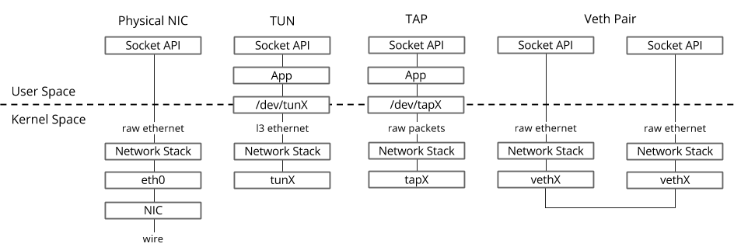
Next: is that all, really?
We will discuss TCP window scaling (flow and congestion control) in RX session.
TCP keep alive => RX session.
xfrm (IPSec) decoding and requeuing. Once decap-ed the packet is requeued back into kernel before finding its eventual final destination which could change from local to forward. IPSEC with ESP header encrypts everything after iph(tcp/udp + payload). Kernel can’t really make a proper routing decision until packet security is asserted and then de-caped.
Bridges are in kernel implementation forwarding. Bridges enables the use of virtual devices. Bridges are not hooked to netfiler. The entire stack checks if there is a bridge involved. However, xtables processing is a messy (before kernel 5.1)
tun: receives IP packets.
tap: receives eth frames.
veth: comes in pairs (similar to duplex pipes or patch cables) allowing forwarding from one default net-stack to namespace-ed net-stack (we will discuss more about them in container discussion).
The key difference with bridges is specialized xtables tables (broute and nat) are executed *before* conntrack.
Other virtual devices (including net_failover) such as bonded devices or teamed devices (enables dealing with multiple physical nics as one logical device this enables LB/active-passive failover at nic level). Typically used in data centers at host level https://developers.redhat.com/blog/2018/10/22/introduction-to-linux-interfaces-for-virtual-networking and https://github.com/jpirko/libteam/wiki/Bonding-vs.-Team-features
Notes:
Be wary of concurrently editing xtables. You have to assume that somebody else might be removing your rules (in a typical high density env) so rules are usually managed by a daemon

